Slide 2
Re-Think Mobile… Beyond Mobile-First
Oracle Mobile Strategy & Mobile Cloud Service
Suhas Uliyar
Vice President Mobile Strategy Product Management
Oracle Cloud Platform
Sept 2, 2015

Slide 3
Notes:
This is a Safe Harbor Front slide, one of two Safe Harbor Statement slides included in this template.
One of the Safe Harbor slides must be used if your presentation covers material affected by Oracle’s Revenue Recognition Policy
To learn more about this policy, e-mail: Revrec-americasiebc_us@oracle.com

Slide 4

Agenda
1
Enterprise Mobile Trends
Mobile Strategy Update & Roadmap
Demo
2
3

Slide 5
The World Has Gone Mobile
We look at our phones more than we look at our loved ones
150 the average number of times a person look as their mobile each day
Notes:
http:/mazharlaliwala.wordpress.com/2013/04/15/mobile-learning-smartphone-and-mobile-app-usage-an-infographic-approche/
medical - http://mobihealthnews.com/7505/72-percent-of-us-physicians-use-smartphones/

Slide 6
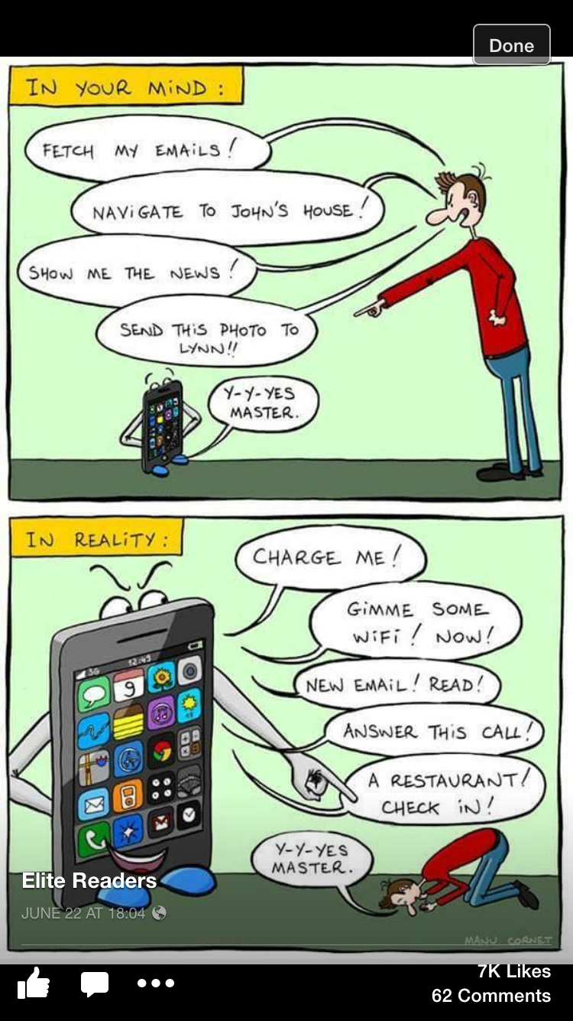
Preview to ‘Phone Story – IV’. My iphone is alive

Slide 7

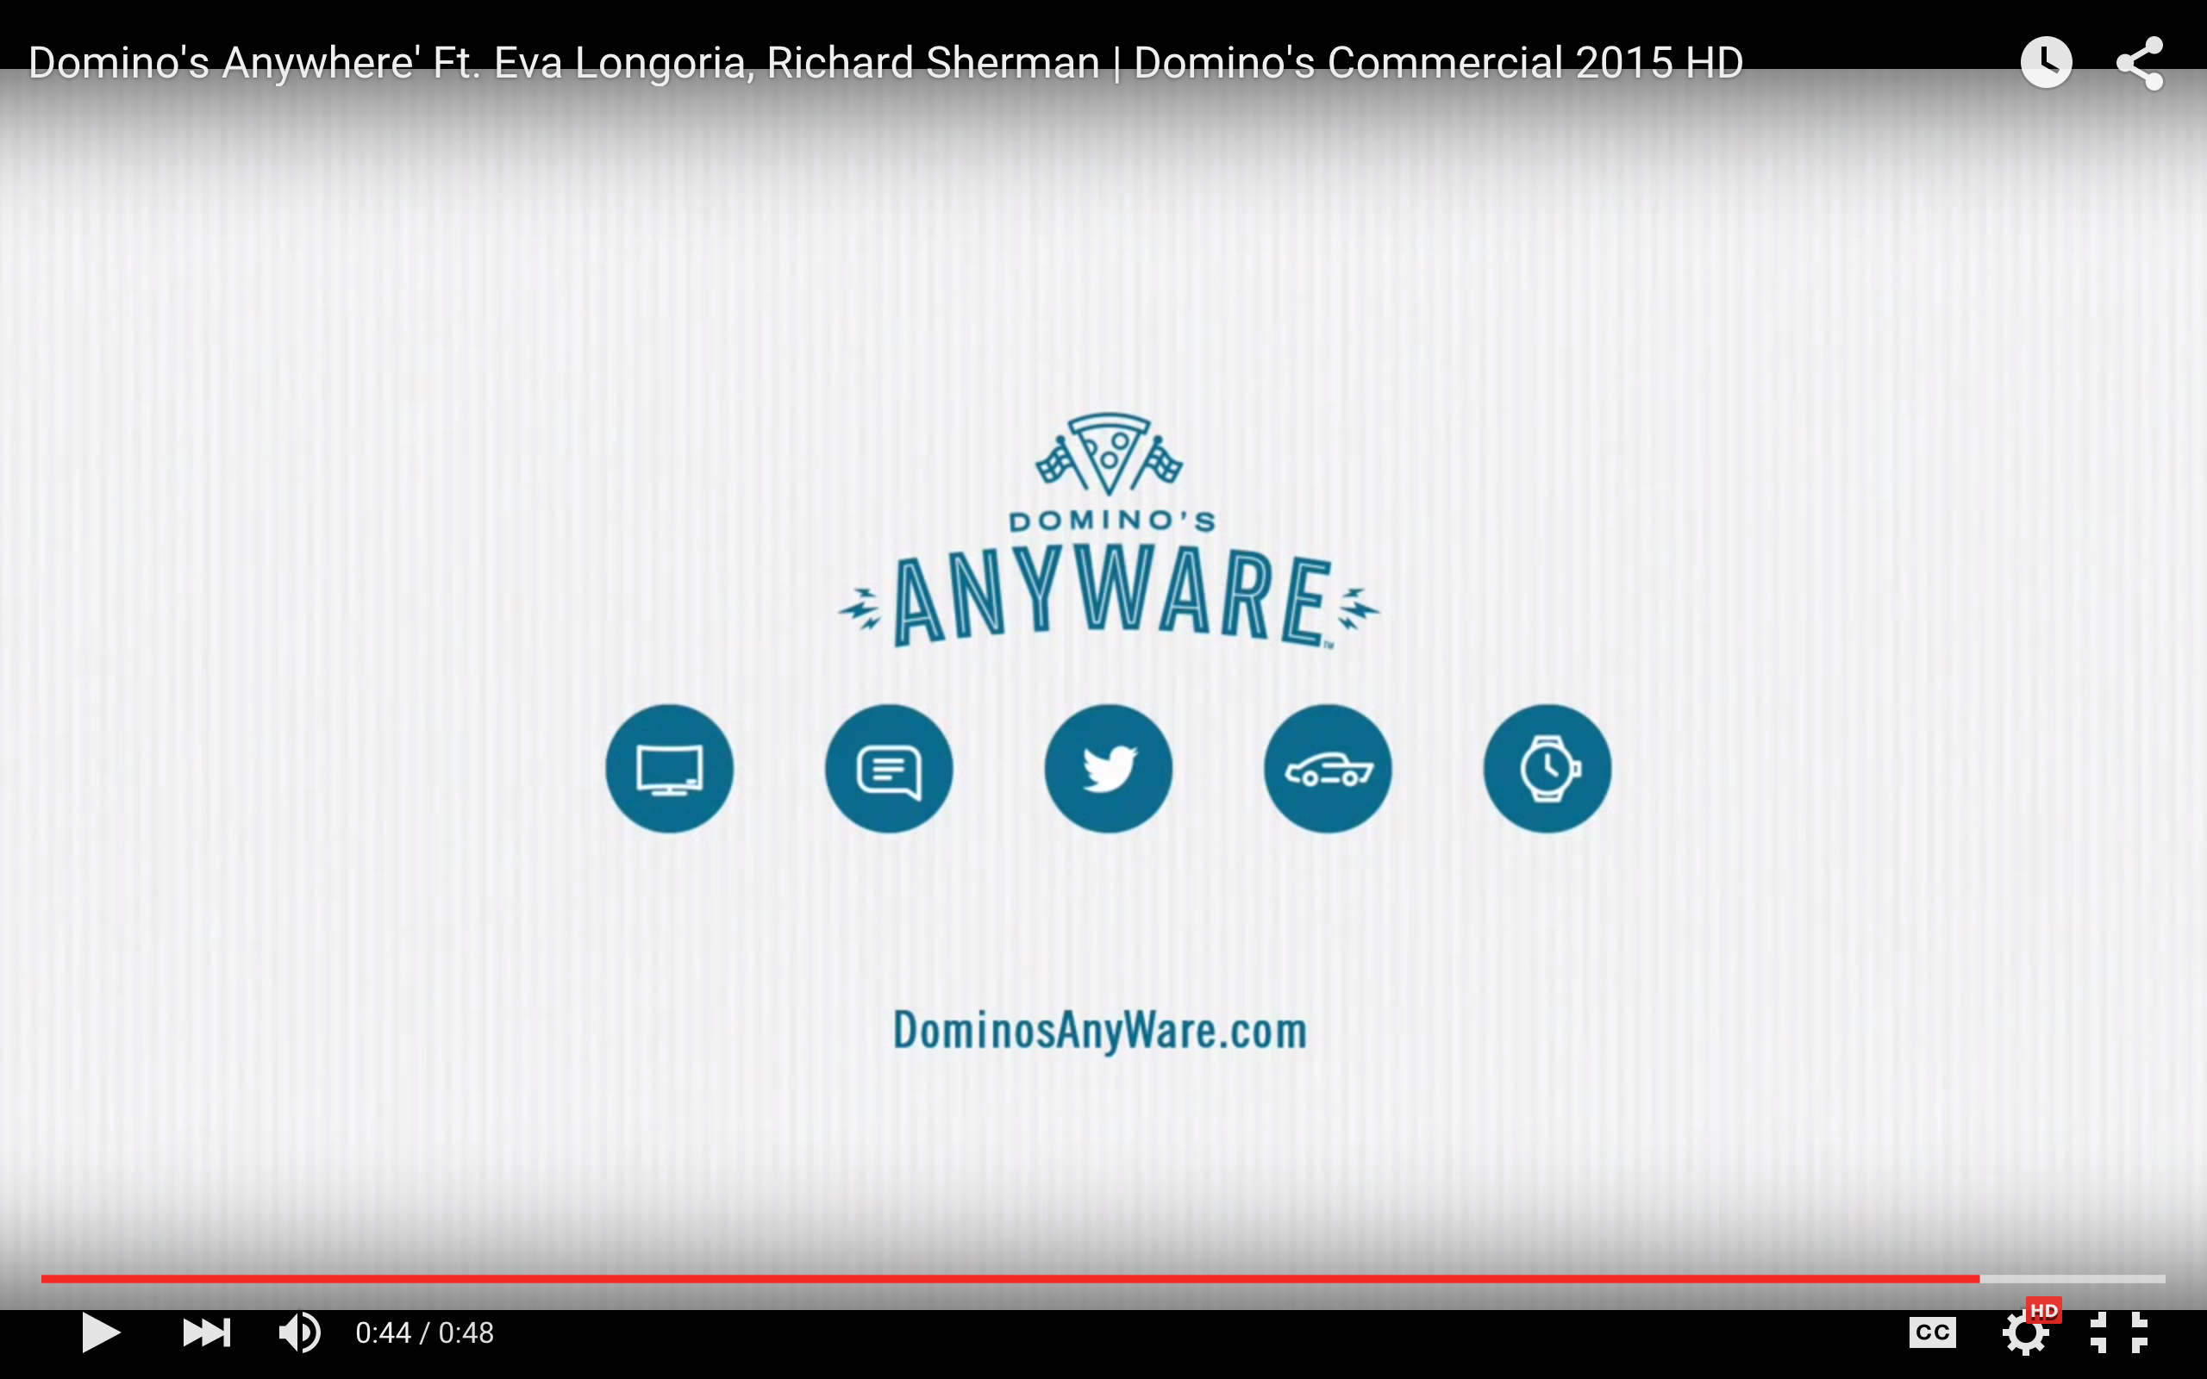
What are Mobile Experiences ?

Slide 8
By 2017, 50% of today's deployed mobile enterprise apps will be completely rewritten or replaced.
By 2018, more than half of all business-to-employee (B2E) mobile apps will be created by enterprise business analysts with codeless tools.
By 2020, lightweight Web- and mobile-style app integration will have completely displaced traditional approaches.
Notes:
Placeholder for text (substitute your own text; delete when not used)

Slide 9
Enterprise App Usage Is Just Starting
2020
Number of Organisations
2018
Email and calendar
EMM
Off the shelf apps
Unmanaged Custom Apps
Portfolio
Large Portfolio
2015
App Maturity

Slide 10
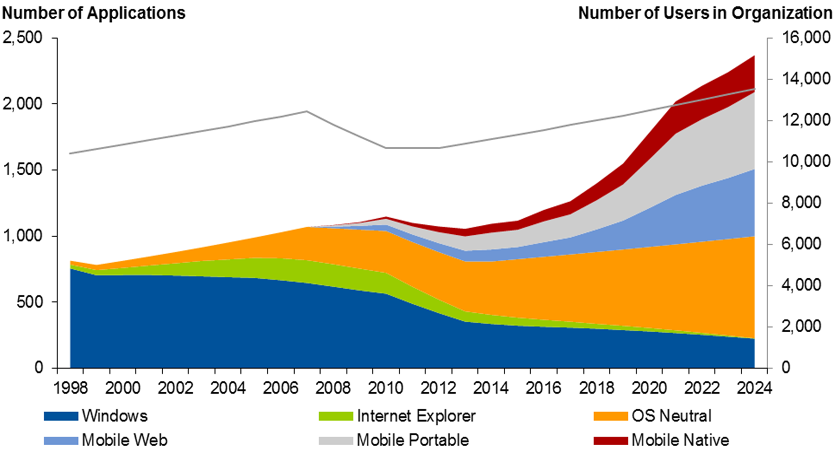
The Enterprise App Explosion
1,400
300
Source: Portable and Web Apps Dominate in Our Mobile Model, Ensuring Maximum Device Flexibility

Slide 11
Changing Developer Demographics
Mobile native developers
Seeking familiarity in unfamiliar territory
PowerPoint
Excel
Access and Similar
Web skills:
HTML5
JavaScript
CSS
.Net and C#
Java
Mobile Native:
Objective-C
Java
XAML
MADP ZONE
Population
RMAD ZONE
Outsource First
Hybrid Zone
Technical Skill

Slide 12
Employee-Facing Mobile Apps Demand Will Grow Through 2017
DYOA tools
MADP tools
RMAD tools
No.of Apps
App complexity and required developer skills
Personal apps
Lightweight apps
Sophisticated apps
Notes:
Tactical guideline: Consider rapid mobile application development tools for tactical employee-facing applications.

Slide 13



Enterprise mobility is hard
Michael Facemire
Principal Analyst
Forrester Research

Slide 14
The challenge is daunting
CRM
HR
Directory
CMS
Directory

Slide 15
Start here
API Strategy
CRM
HR
Data Access Strategy
Directory
Superior UX Strategy
CMS
Directory

Slide 16





Mixed
Mixed control
Front end Development Tools
MAF + MAX + ABCS
APIs
APIs
APIs
APIs
APIs
APIs
APIs
APIs
IT Controlled
Mobile Application Integration Platform, typically mBaaS
Location
MCS
Integration
Data Orchestration
Analytics
Data Encryption
IAM
ICS
PCS
MCS
MCS
IDCS
Push Notifications
MCS
Data Synchronization
API Management
API Discovery
Versioning
Collaboration
DOCS + Social
Inside APIs
SOA / OAG
Existing Apps
JCS
Existing On Prem Back-End Systems
SaaS

Slide 17
Oracle Mobile Strategy & Roadmap

Slide 18
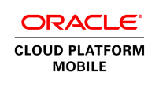

Oracle Mobile Platform: Simplifies Enterprise Mobility
Build & Deliver Mobile Apps with Seamless, Secure Access to Mission-Critical Data
Custom Mobile Apps
Packaged Mobile Apps
Partner Built Mobile Apps
Develop
Integrate
Analyze
Secure
Manage
Notes:
Speaker’s Notes:
Oracle’s Mobile Portfolio provides a complete end to end solution that manages the entire mobile lifecycle. The key tenants to Oracle’s mobile solution is to provide a platform that allows customers to develop, connect, secure, analyze and a manage their mobile applications. With our platform customers, can build customer apps or use and or extend our 100’s of packaged mobile apps.
With Mobile Cloud Service ( which now together with Mobile Application framework) we provide all the capabilities needed to build, connect, secure, analyze and manage mobile apps quickly and efficiently. We provide Mobile Security Suite which not only is integrated with MAF/MCS but also tightly integrated with our IDM Suite – is an integral part of our Mobile offering but also can be de-coupled and used as part of a broader enterprise security initiative.
Finally Oracle and our partners continue to provide standalone out of the Mobile apps across our on premises and Cloud offerings.

Slide 19
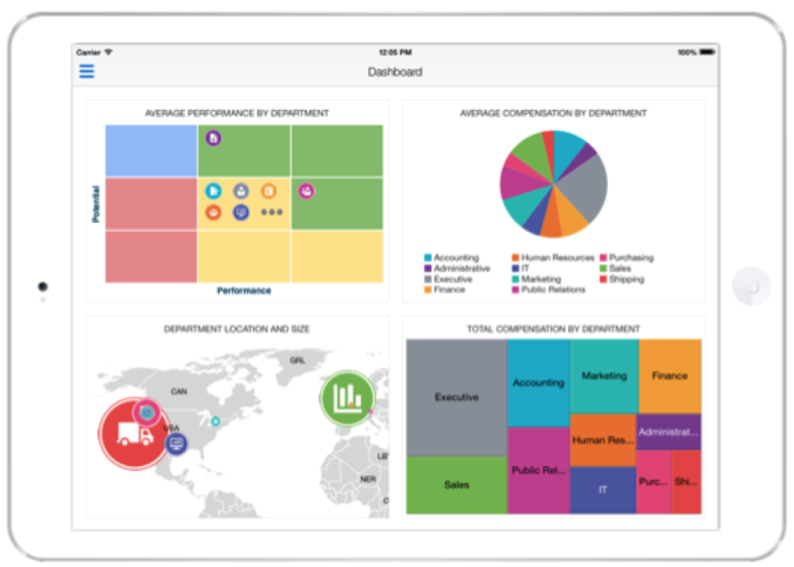
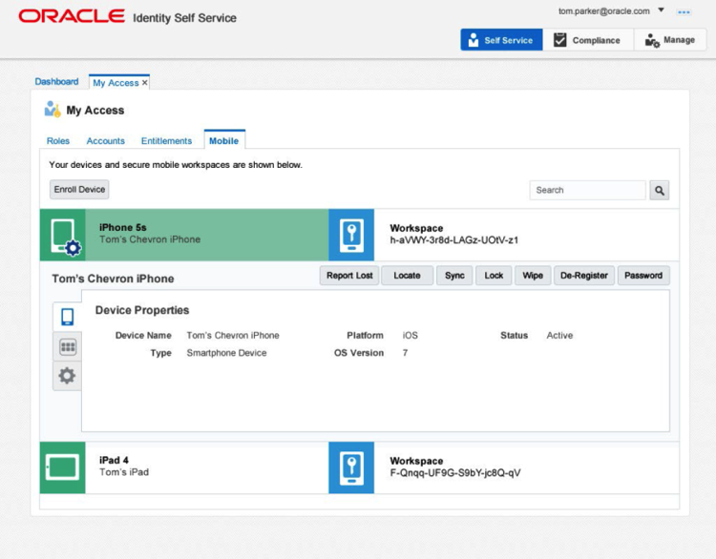
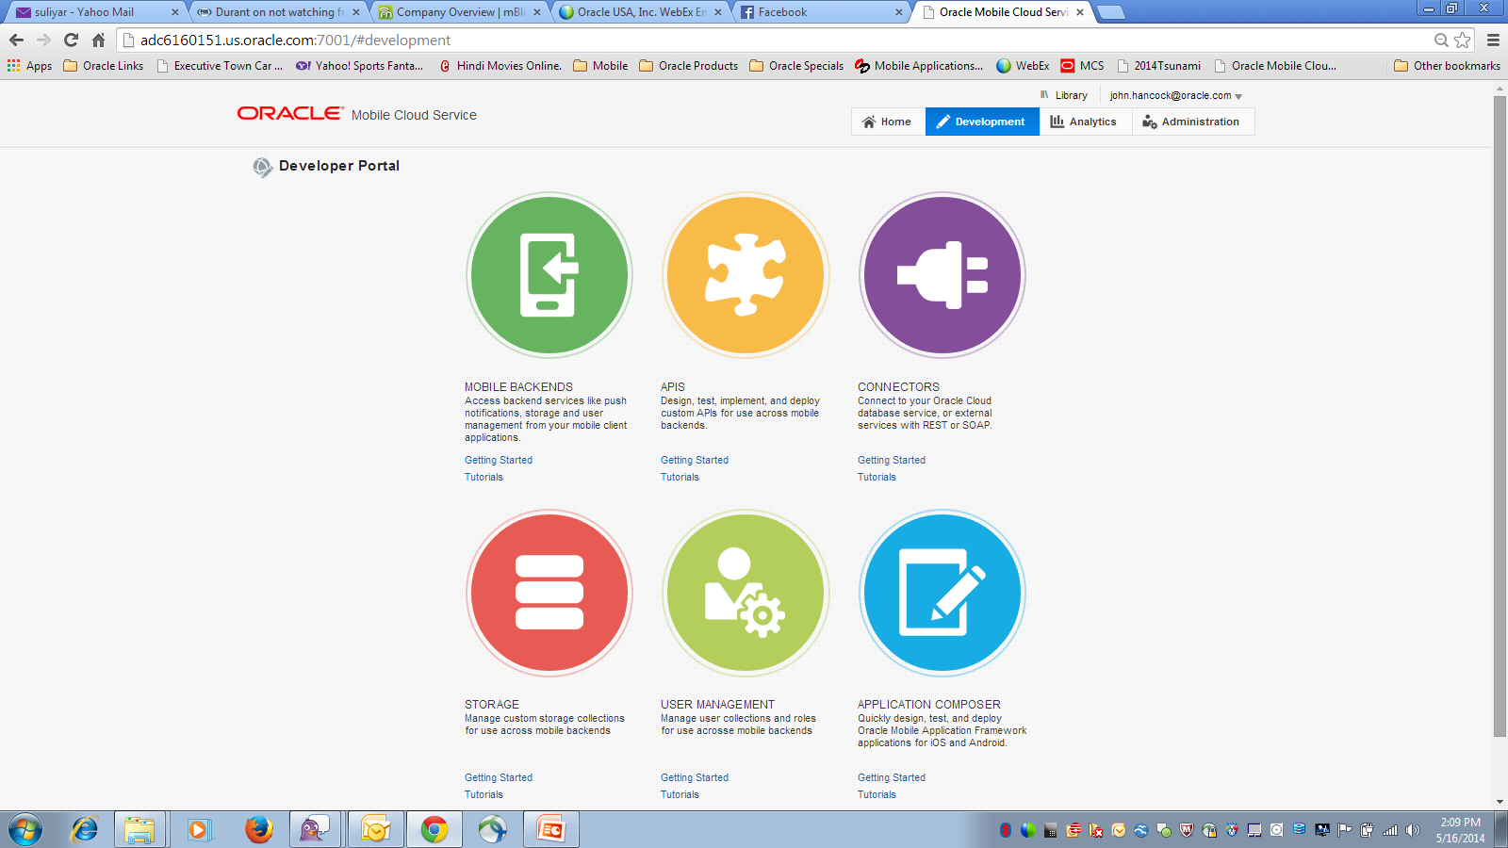
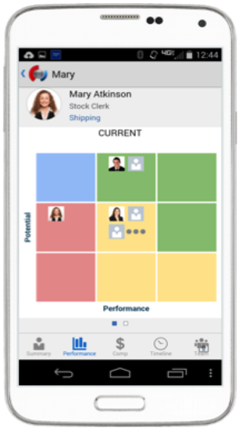
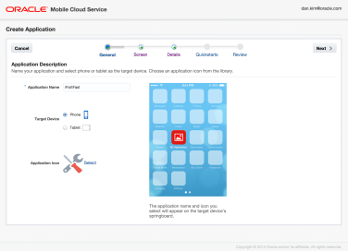
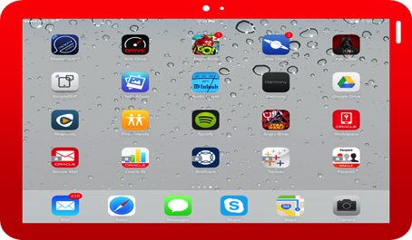
Oracle Mobile Platform - Today
Develop, Integrate, Secure, Deploy & Manage
Develop
Integrate, Monitor & Analyze
Secure, Deploy & Manage
Mobile Application Framework
Mobile Cloud Service
Mobile Security
19
Notes:
Oracle’s platform strategy has 3 main components. All of these components are integrated but de-coupled. You can mix and match any of these components. Mobile Cloud Service is our key offering for providing all the enterprise backend services that mobile client developers will need to deliver mobile applications.
MAF provides all the tools for mobile client tool developers to build cross platform mobile applications
Oracle Mobile Security provides the complete enterprise mobile management components including MDM, MAM, MIM, MCM

Slide 20
Key Mobile Investment Areas
Development
Security
Analytics
Testing
No Code Tools
Cloud
User Engagement
Mobile App Testing
Eco System
(Marketplace)

Slide 21

Development
@OracleMobile
21

Slide 22
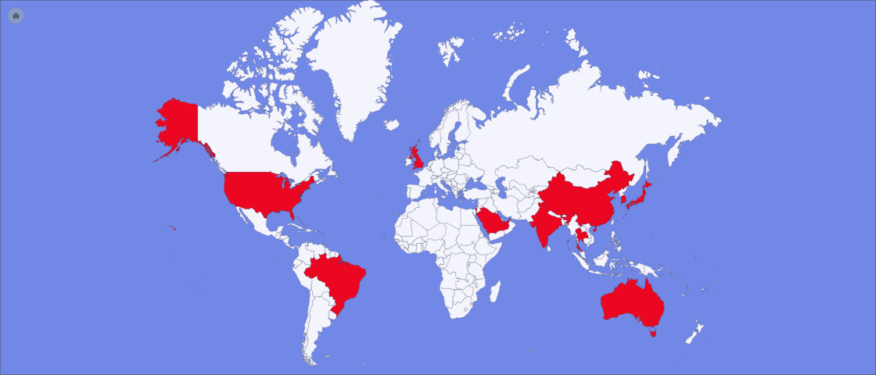

2016: The Year of Oracle Mobile
Mobile Cloud Service is here!
We have customers in every Oracle Geo ☺
We are beating established competitors
€
¥
$
$
£
¥
$
€
€
£

Slide 23
MCS Roadmap – Building the business
By 2017, companies will spend $189 billion to enable mobile services
V1.1 – Targeted for Nov 2015
Full Bi-directional Offline / Data Sync
Windows, JavaScript SDK
Push for Windows
Solution packaging
Integration Cloud Connector
V1.2 – Targeted for Feb 2016
MAX
Oracle on Oracle, Oracle Marketplace
Location Services, SMS
Rich JavaScript IDE / GIT
Enterprise User SSO
V1.3 – Targeted for May 2016
Engagement (Actions, Rules)
Mobile Dashboards
Service Mapper
Actionable Notifications on Wearables
Michael Facemire
Principal Analyst
Forrester Research

Slide 24
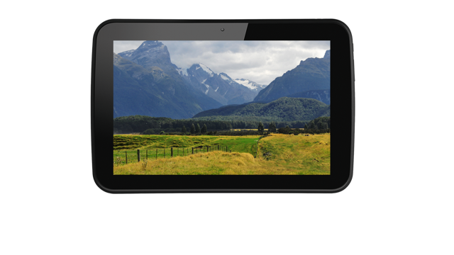
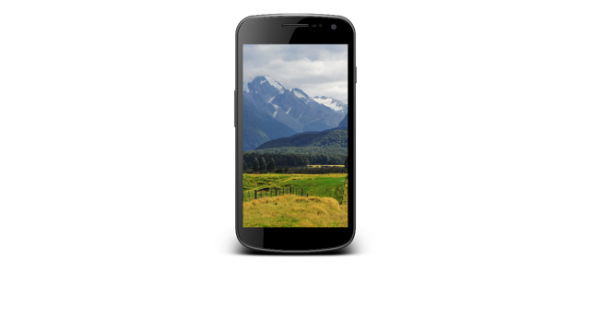
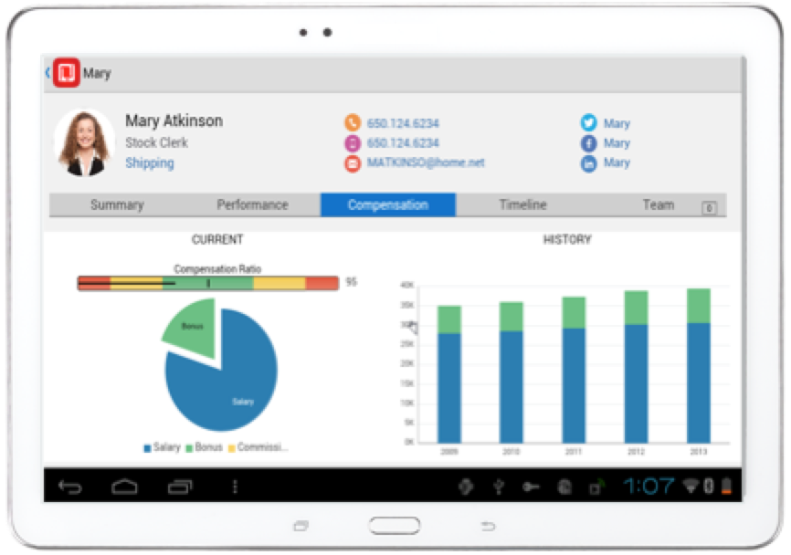


MAF Roadmap
2.1.3 – Released 8/24/15
Extensive security update
Mobile Cloud Service authentication and integration
Oracle Mobile Security Suite Integration for both iOS and Android
2.2.0 – Targeted for 10/9/15
Major UI features: Android 5 look and feel, Swipe-to-reval on list, Pull-to-refresh on list, Masonry Layout, Flex Layout, new animations, Visualization enhancements
Other features: Full Android back button support, nested Data control contexts, internal automation support
Performance improvements overall (~25-30% faster in page renderings)
2.3.0 – Targeted for 2/15/16
Major features: Declarative Offline Support, MCS Service Browsing, Performance Analytics, Integrated MCS Diagnostics/Analytics, Security enhancements
Platform upgrades: Windows 10 client support, XCode7/iOS9, Android 6, Cordova 4
Notes:
Add table that shows which things they can do

Slide 25
What is JET?
Oracle JET is a JavaScript Extension Toolkit(JET) targeted at intermediate to advanced JavaScript developers working on client-side applications. It's a collection of open source JavaScript libraries along with a set of Oracle contributed JavaScript libraries that make it as simple and efficient as possible to build applications that consume and interact with Oracle products and services. Specifically Oracle Cloud Services.

Slide 26

JET Architecture
UI Components
Web Services
Framework Features
Cornerstone
Libraries
Knockout
Require
jQuery
jQueryUI
Common
Model
REST
WebSocket
SSE
LocalStorage
Browser
Notes:
The two key points to emphasize when talking about JET are:
Modularity
Enterprise focus
With these two points, everything else follows. The choice to use a collection of Open Source libraries like Knockout.js, RequireJS, jQuery, and others, was because of the desire to provide a framework that was as modular as possible. It would be flexible to change, unlike other frameworks that are more prescriptive and have proven to require a complete rewrite of your application to move to a newer version of the framework. (Angular 1.x to 2.x)
By focusing on Enterprise requirements, such as Accessibility, Internationalization, advanced Data Visualization and Mobile first, we are providing value add over what is already out there, instead of trying to reinvent the wheel.
I like to use the phase, "The only constant in life is change", and we have developed a framework that is ready for that type of JavaScript world.

Slide 27

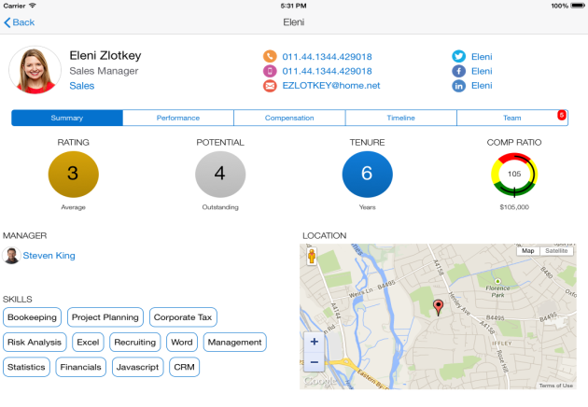
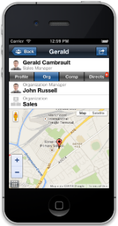
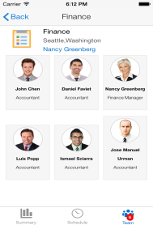
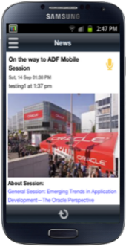
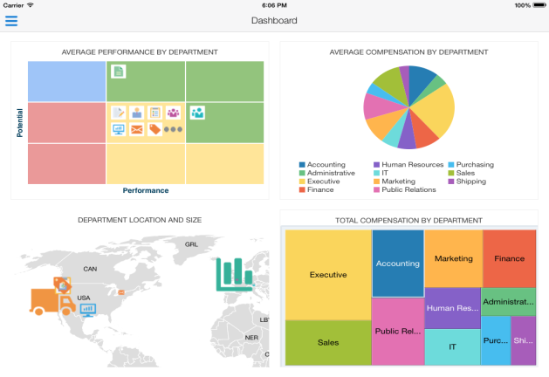
Multi Channel App Development with JET & JET Mobile
JET Mobile = JET + Cordova + Oracle Cordova Plugins (Security, Sync etc)
Focus on JavaScript developers as mobile developers, not ADF developers as mobile developers (like MAF)
Keeps JavaScript developers inside their “IDE” of choice, via independent project, build and deployment JavaScript infrastructure (Grunt, Yeoman..etc)
Give away restricted use licenses for JETMobile with MCS, ABCS, etc. Consider making open source.

Slide 28
MAF
Target audience
Oracle Apps Developers
Declarative & Customization Developers
4GL declarative programming paradigm
Brand, Customize, Extend Apps
Componentize & reuse Apps
Protection from platform changes
Upgrade safe
Reduce total cost of ownership
Native mobile Look and Feel
Device access, local notifications, SqlLite
JETMobile
Target audience
Hybrid mobile developer with skills in HTML5, JS, CSS
Large Java Script component set with native mobile skins
Pluggable architecture
Simple two-way data-binding
Non-proprietary, standard HTML markup
Custom UI via HTML/CSS/SCSS
IDE of choice tooling
Supported version of Cordova container with native plug-ins and SqlLite

Slide 29
JET Mobile Functionality Timeline
Functionality | Now | JET V1.2 (12/2015) | JET V1.3 (06/2016)
Mobile Patterns
Mobile-ready components
Native components and styling
Tooling to create new mobile hybrid apps with templates
Performance Guidelines
Demos / Cookbooks
OOTB Security / Encryption
Offline
MCS Analytics / Diagnostics Integration
No Support
Minimal Support
Partially supported
Mostly Supported
Fully supported

Slide 30
Oracle RMAD - No code everywhere
Appeal to the line of business
Mobile client
Mobile optimized web
Mobile test authoring
Mobile analytics instrumentation
Mobile API creation
Code

Slide 31

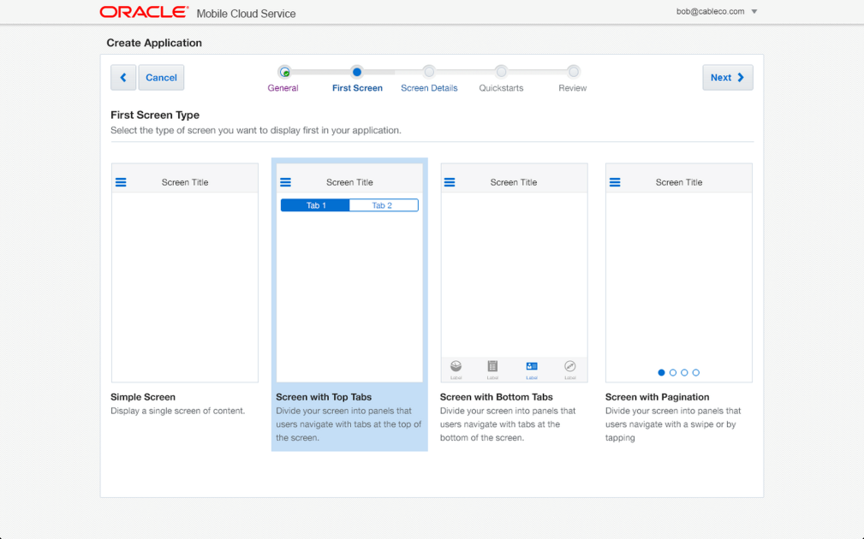
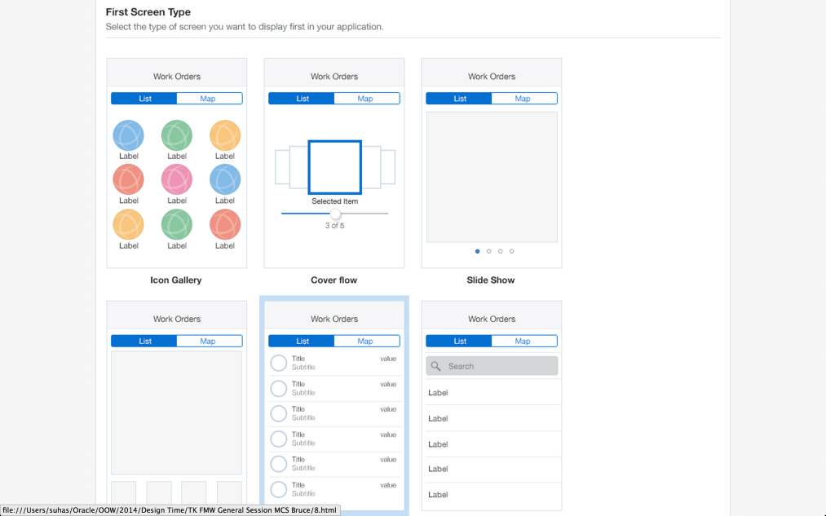
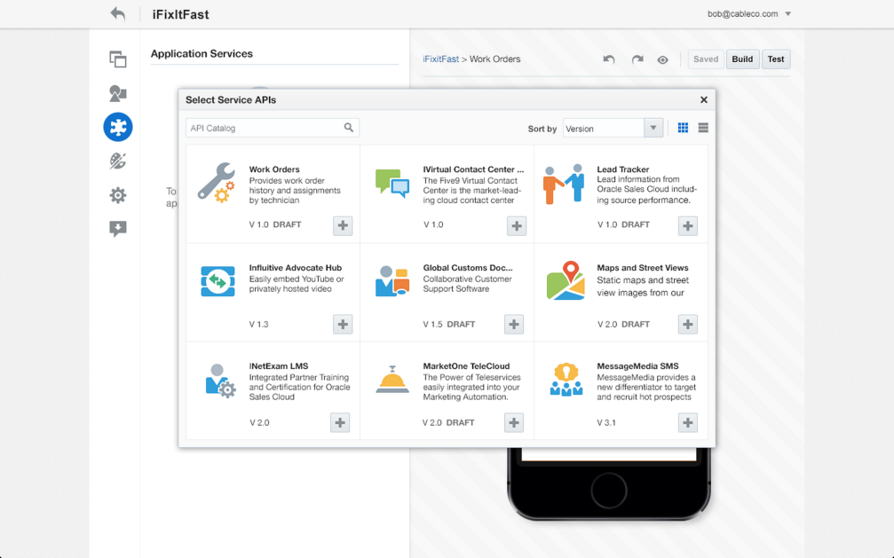
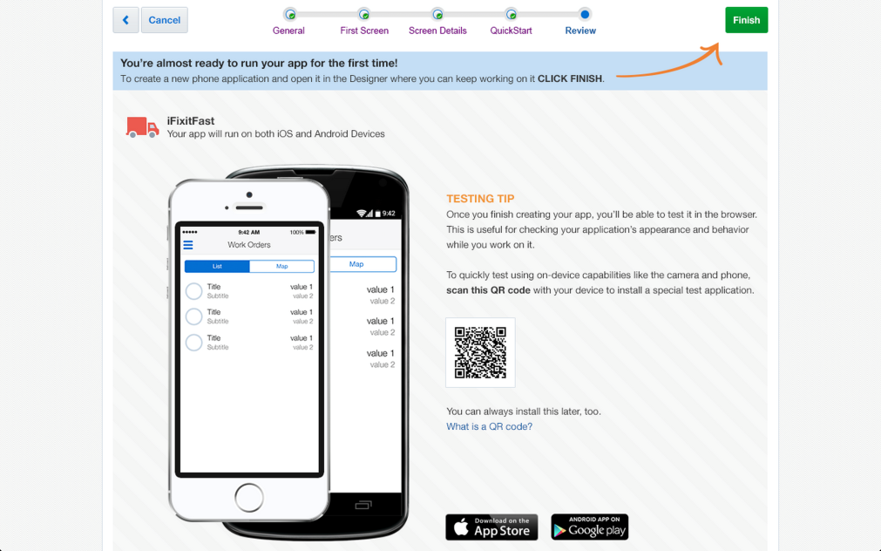
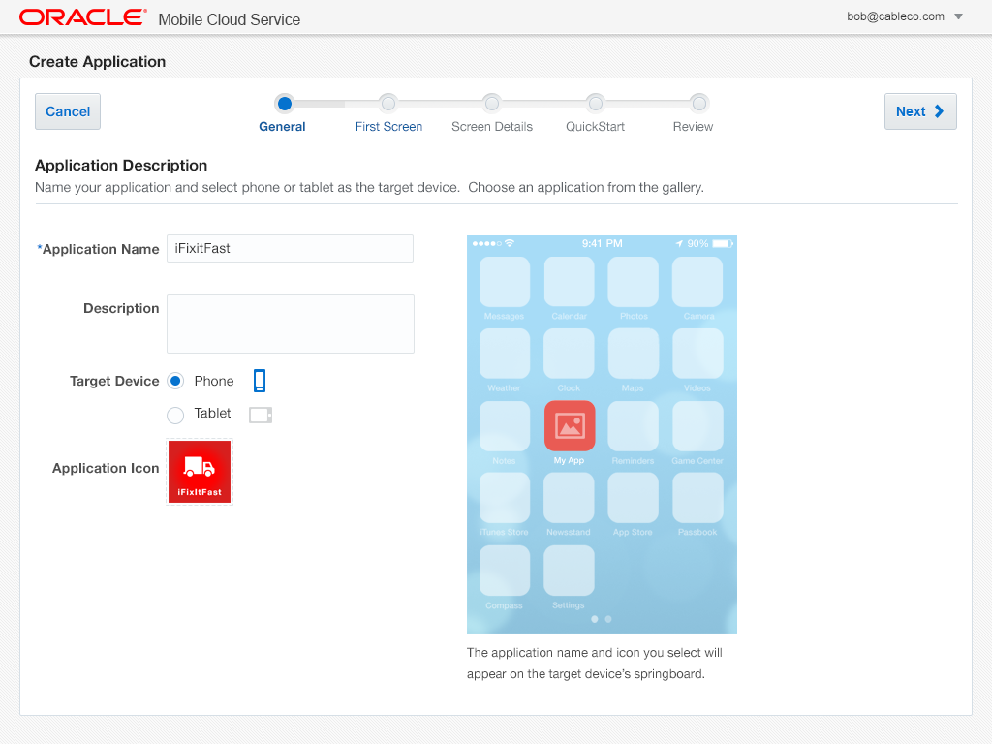
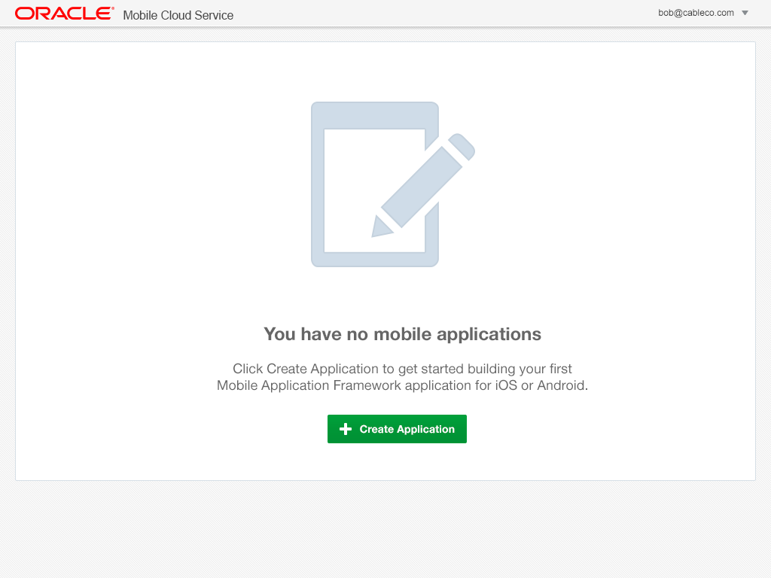
MAX and ABCS
Business User Friendly Multi Channel App Composition in the Cloud
Browser based development
No coding required
Easily map to business services
Preview app in line
Edit, test, and publish from browser

Slide 32
DEMO
@OracleMobile
32

Slide 33
Security
@OracleMobile
33

Slide 34
Oracle Mobile Security Strategy
Offer a cloud based Enterprise Mobility Management (EMM) solution
70% of new deals in cloud and revenue trend increasing quickly. On-prem revenue waning (MOBL, Good)
Enables us to move faster, easier bundling/upsell – single point of app security with Mobile Cloud Service (MCS)
Position mobile security as part of the overall Identity Cloud Service (IDCS) market offering
Establish the EMM baseline & keep pace with velocity of change
Meet minimum EMM requirements and shore up MDM/MAM capabilities
Day 0 support for new iOS, Android, Windows enterprise features
Focus on the differentiators (Mobile Identity & MCM)
LEADER in risk-aware secure identity for Consumer & Employee
APIs for partners to consume mobile context (NAC, CASB, SWG)
Leverage Oracle breadth
Complete mobile platform story with mobile PaaS (employee & consumer)
Pre-wrapped Oracle SaaS/PaaS/Apps Unlimited Apps facilitates enrollment and upgrade to advanced features
Notes:
NAC – Network Access Control
CASB – Cloud Access Security Brokers
SWG – Secure Web Gateway

Slide 35
OMSS 11gR2 PS3
Bundle Patch updates in addition to bug fixes
PS3 BP01 (released)
Document creation and annotation using secure editor app
Touch ID for workspace authentication on iOS
PS3 BP03 (planned for 15-Sep-2015)
Audit reports detailing device/workspace policy changes, app changes and user events
Planned OS version certifications
Same day certification of Secure Workspace on iOS 9
Same day certification of Secure Workspace on Android M
Note: Support for new features of iOS 9 and Android M are planned for MSCS v1

Slide 36
Mobile Analytics
@OracleMobile
36

Slide 37




Mobile Proliferation Challenges C-Suite to Rethink Strategy
$3.2
^{Trillion}
By 2017, mobile commerce transactions will reach $3.2 trillion*
Mobile’s Complexities
Close mobile’s analytics gap and plug hole in multi-channel analysis
Move beyond reviews and downloads as Key Performance Indicators
Leverage real-time context for personal engagement and monetization
Reduce development complexity while proving and enhancing app ROI
150
^{Billion}
*Source: Various: Need from Oracle CI Team if used
In the past 5 years, 150 billion apps have been downloaded
Demands Modern Approach
Limited Mobile App
and User Insights
User Experience
Expectations
87
^{Percent}
*Source: Need Source
Companies update or release mobile apps at least every 6 months*
Demonstrable ROI
Not Apparent
Portfolios of Employee and Customer Apps
78
^{Percent}
*Source: Triangle Research Survey, 2014
78% of apps have no mobile analytics to measure and optimize performance*
Rapid Platform
Evolution
Mobile Data Loss
and Breaches
*Mobile Business Statistics, CSO Online 2014

Slide 38

Mobile Analytics
Understand
Collect
Engage
Convert user data into actionable insights
Solve a business need through targeted user engagement

Slide 39











Enable Modern Enterprises to Transform Operations Leveraging Advanced Mobile Technologies
Marketing
Make personalized connections and provide location-based incentives
Retail
Leverage real-time inventory management with location and user-based promotions
Sales
Real-time proposals on mobile devices that accelerate B2B sales cycles
Hospitality
Engage with guests using timely, personalized, and location-based context
Commerce
Create customized offers to reach shoppers anywhere, anytime
Financial Services
Extend relationships with users based on transaction and engagement history
Customer Service
Streamline tasks, staffing, and parts sourcing, improving remote customer service
Media
Deliver content and advertisements to maximize engagement and monetize users
Human Capital Management
Find, recruit, and hire candidates via mobile channels on any device
Logistics
Optimize fleet scheduling and routing to improve driver and dispatcher productivity
* Pending

Slide 40
Mobile Analytics Roadmap
Next 6 months – Establish MA
End of CY16 – Expand MA
Beyond – Packaged Solutions
Mobile Program Manager, Analyst
User Profiles & Segmentation
Funnels/cohorts, retention, revenue
BI Visual Analyzer
Marketing, User Engagement
Real-time and segmentation based actions (push messaging)
Mobile Program Manager, Analyst
User lifetime value
Location based visualizations
Marketing, User Engagement
A/B Testing
Custom engagement & actions
In-app messaging
Mobile Developer, Enterprise Architect
Crash analytics
In-app performance metrics
Mobile Program Manager, Analyst
Predictive analytics
Machine learning
Marketing, User Engagement
Rule engine based actions
Verticals
Responsys integration
Oracle SaaS integration

Slide 41
Mobile Testing
@OracleMobile
41

Slide 42
Mobile Testing Challenges
Poor User Experience is #1 cause of adoption issues (native, hybrid, mWeb)
Bugs are #1 cause of bad app ratings
Apps must be tested on various application platforms prior to release
Different versions of Android and iOS
Different device characteristics such as screen rez and memory
Different makers and models
Like browser compatibility testing but worse!
Difficult to share a pool of Android and iOS devices among developers and testers
“Who’s got the iPhone 5?”
Risk of devices with pre-released apps getting lost or stolen
Difficult Integrating physical device testing into continuous integration/deployment

Slide 43
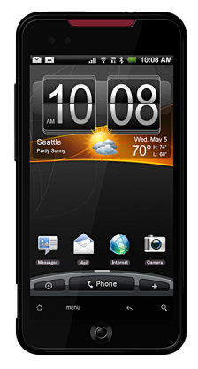
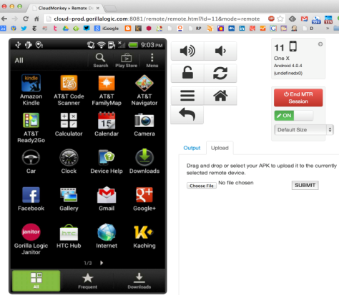
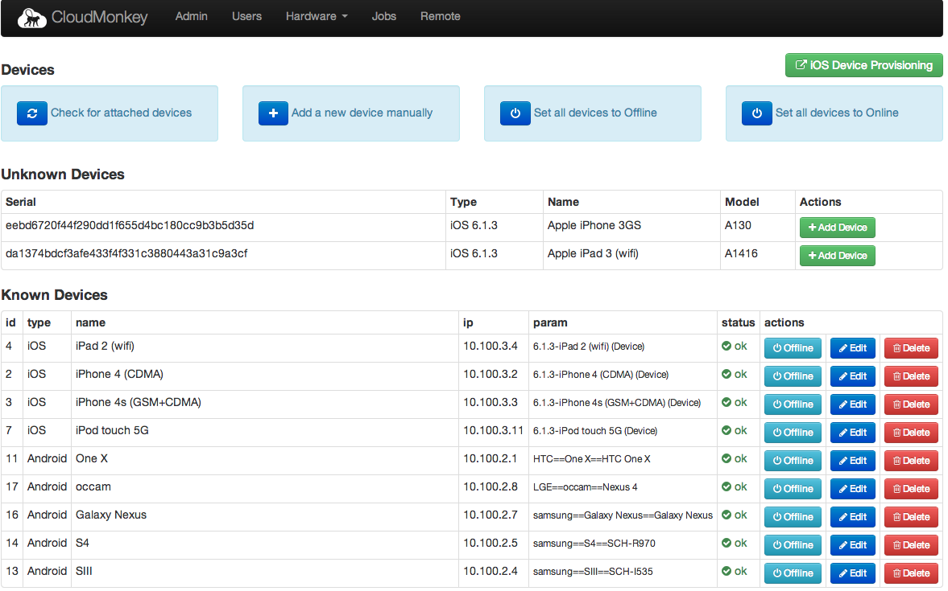
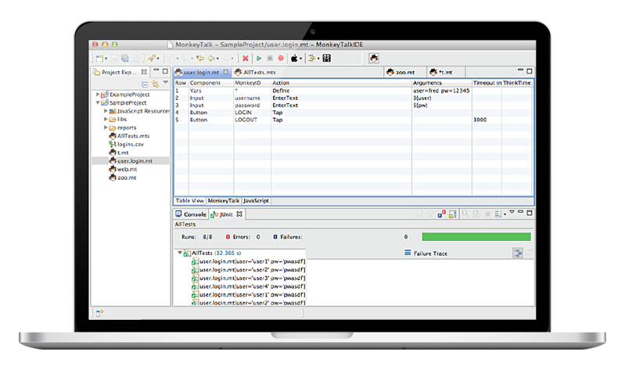
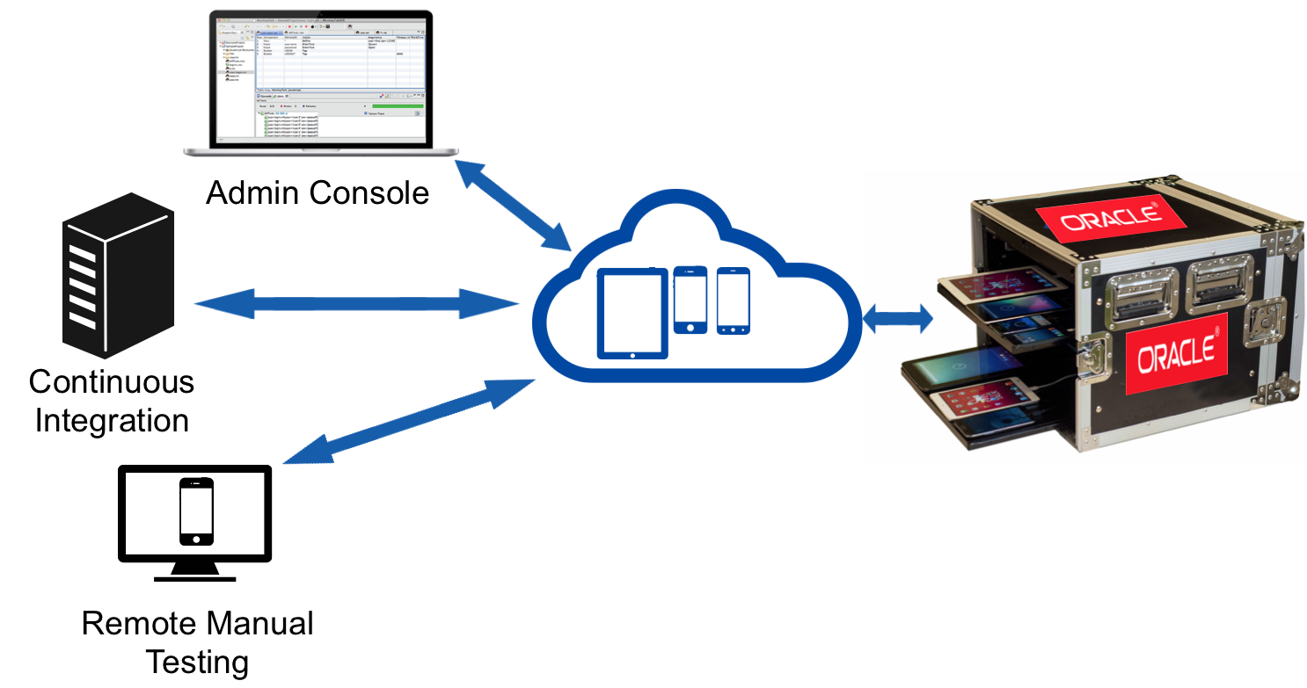
Oracle Monkey Talk Product Overview
Monkey Talk & Lab Manager – Local, Remote, Corporate Wide, International
Monkey Talk |  | Lab Manager
Cross-platform iOS and Android mobile test automation tool – record and play Runs tests interactively or from continuous integration environments Supports native, mobile, web and hybrid environments – Oracle MAF/MAX aware Remote testing/access/debugging of physical devices | Supports multi-device testing scenarios (e.g., chat between two phones) Record manual test scenarios on actual device/emulator and playback anywhere | Oracle Infrastructure Integration (100 – 1000s of devices) for internal purposes Tool that manages manual and automated testing on real devices in distributed or lab environments Runs automated mobile tests in parallel across devices Automates builds and tests together into a single workflow

Slide 44
Mobile Eco System
@OracleMobile
44

Slide 45




Mobile Cloud Service– An Ecosystem Extends and Connects
Systems We Can Connect To
Mobile
Cloud Service
Apps That Can Be Built
Services We Offer

Slide 46
Eco System – Partner Strategy
Client Tools
Xamarin
Sencha
Value Added Services
Syniverse
HERE
Connector Providers
Aura Player
Payment
Proximity
ISV
Rapid Value
Venture Forth

